Slide 1
Heart of Knowledge
Week 1 Progress Update
Code-Blooded
Sammy Jones, Michael Schriefer, Zachary Mcnay, Peyton Hayes

Slide 2
Overview for Week 1
Wrote 156 Lines of Code
Overall Burndown Rate: 12.5%
Found 28 Requirements
7 Fulfilled
Burndown Rate: 25%
Found 73 Tests
0 Completed
Burndown Rate: 0%

Slide 3
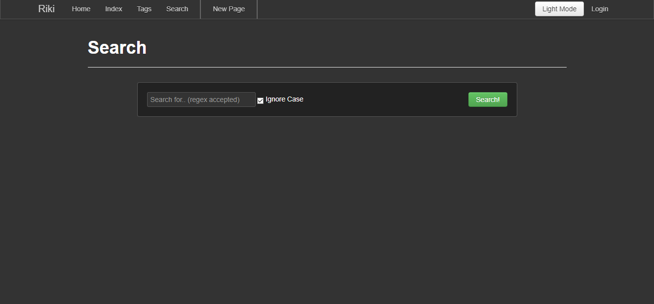
Feature 1 - Dark Mode
This week I focused creating the dark.css file and updating the base.html for the dark mode. I spent most of my time reading and understanding bootstrap.css.
125 lines of code was written
3 requirements
10 tests including Unit,
Integration, Regressions,
and Acceptance

Slide 4
Feature 2 - Custom Templates For Pages
This week I spent most of my time reading and understanding bootstrap.css and how to create a new .css file that overrides the setting in that.
0 lines of code
2 requirements
3 requirements
10 tests including Unit, Integration, Regressions, and Acceptance

Slide 5
Feature 3 - User Default Template
This week I spent most of my time reading and understanding bootstrap.css and how to create a new .css file that overrides the setting in that.
0 lines of code
2 requirements
3 requirements
10 tests including Unit, Integration, Regressions, and Acceptance

Slide 6
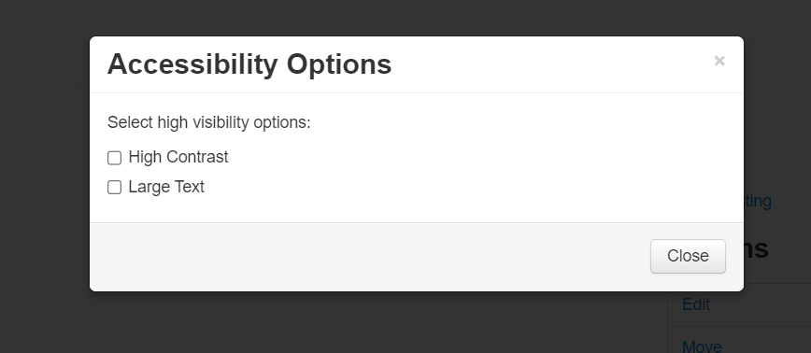
Feature 4 - Visibility/Accessibility Modifier - Peyton
This week I focused on creating a button in the navbar that could open a pop-up window. This kind of pop-up window will be used for both features 4 and 5 and possibly other features as well.
31 Lines of Code Written
8 Requirements (3 Met so Far)
12 Tests including Unit, Integration, Regressions, and Acceptance
38% Burndown

Slide 7
Feature 5 - Citation Generator - Peyton
This week was spent working on feature 4 but the pop-up window aspect is applicable to this feature as well. Each article will have a button that creates a pop-up with citations ready so knowing now how to add pop-ups will help later on.
0 lines of code written
7 Requirements
13 Tests including Unit, Integration, Regressions, and Acceptance
0% Burndown

Slide 8
Feature 6 - Instructions / Tutorial Page
This week I have been mostly focusing on other projects that have taken priority due to current due dates. I plan to create a dedicated page with all available features and possibly bubble pop ups with each that contain a small description.
0 Lines of code written
2 Requirements
8 Tests including Unit, Integration, Acceptance, and Regression Testing
0% Burndown

Slide 9
Feature 7 - Table of Contents / User Privilege
This week I have been mostly focusing on other projects that have taken priority due to current due dates. I plan to create a function to allow privileged users to assign a user level which will allow only those users to view same user pages. Also have an option to move the page links to the side of the screen.
0 Lines of code written
2 Requirements
10 Tests including Unit, Integration, Acceptance, and Regression Testing
0% Burndown

